Slide 1




CONFIDENTIAL
September 2023

Slide 2

CONFIDENTIAL
helps Property Managers
Protect their business by providing coverage for the things they can’t afford to replace
and
Grow their business by eliminating guest and homeowner friction and helping them recruit more homeowners.
INTRODUCTION

Slide 3
















CONFIDENTIAL
$100B
95%
2013
2023
Insured by Safely
in the US
Annual Customer Retention
Founded
Expanding to Europe!
(licensing pending)
ABOUT SAFELY
Notes:
Lloyds coverholder

Slide 4

CONFIDENTIAL
Homeowners assume the worst;
one bad stay can be a catastrophe for them and a Property Manager’s business
THE PROBLEM

Slide 5






CONFIDENTIAL
What happens when
something goes wrong?
Safely is there for Property Managers, their homeowners & guests
with up to €1,000,000 of embedded commercial insurance
Covers damage
to the home’s structure
Covers damage to the home’s contents
Covers property manager and homeowner for guest injury liability
THE SOLUTION
!
Pet Damage
Bodily Injury
Theft
Stupidity
(Unintentional Acts)
Intentional Acts

Slide 6

CONFIDENTIAL
Safely Per-Reservation Insurance Eliminates Friction
Reliably Covers the Unique Risk Created by Short-Term Guests
NO MORE
Hassling guests
NO MORE
Damage deposits
THE SOLUTION
to admit fault and pay for repairs and damages resulting in bad ratings / reviews
€0 deductible policies completely replace the costly administrative nightmare
Active only when there
is a paying guest
Primary Coverage
60 days to file a claim with estimates or receipts
Claims management expertise
!

Slide 7





CONFIDENTIAL
What’s NOT
covered
NOT COVERED
Home for
personal use
Acts of Nature
Maintenance Issues (wear & tear)

Slide 8
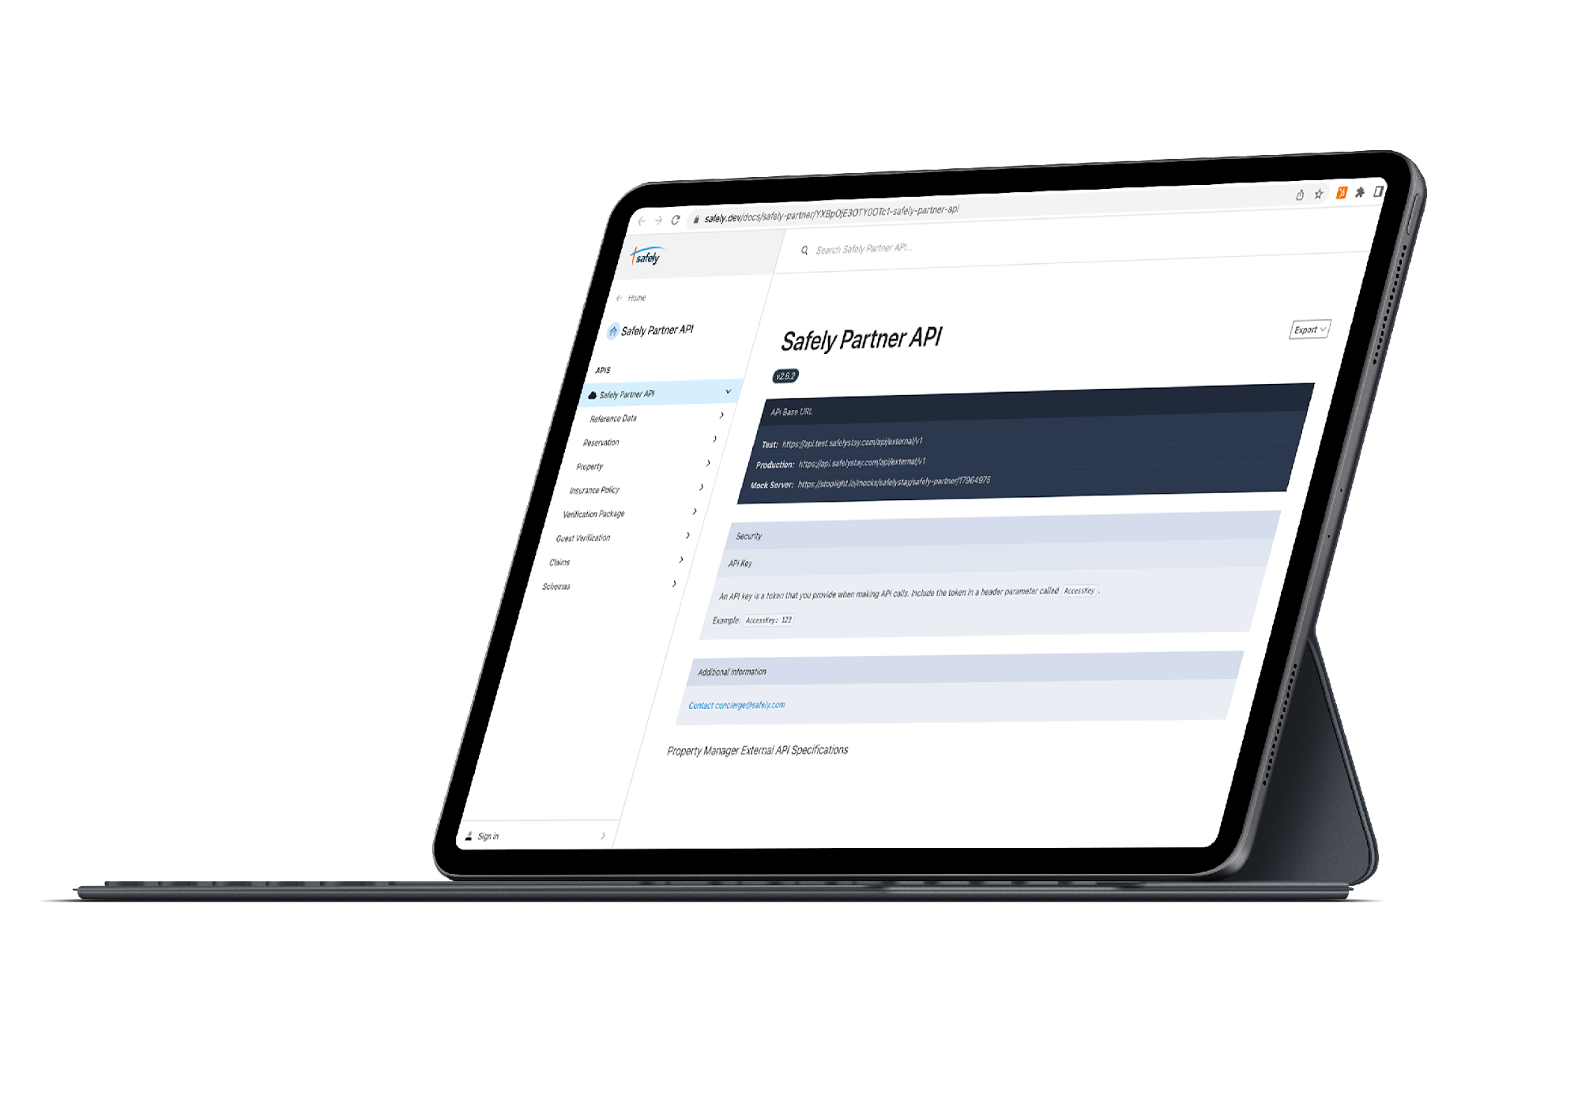
CONFIDENTIAL
Our solution is enabled by our API integrations with Property Management Systems
CLAIMS PROCESS

Slide 9







CONFIDENTIAL
Submitting Safely Claims Takes 5 Minutes
CLAIMS PROCESSING
Enter Claim Details
Attach
Photos
Attach
Invoice or Estimates
NO Guest Involvement
*For Damages

Slide 10

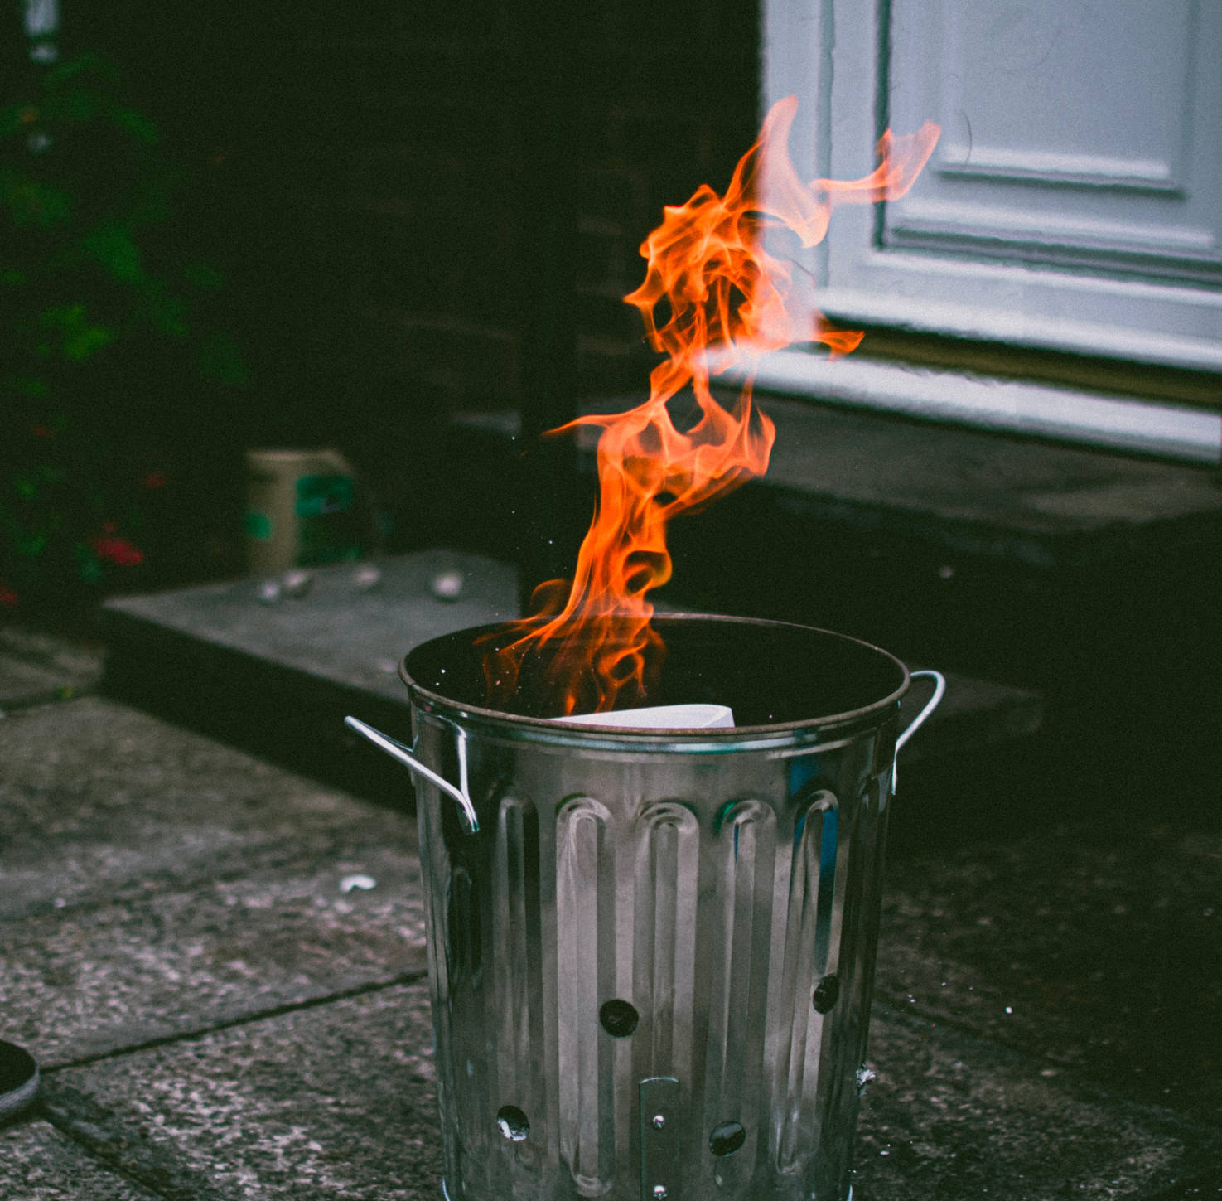
CONFIDENTIAL
Safely at Work: Claims We Covered
COVERED CLAIMS
Rooftop skier
Puff the Magic Dragon
A guest​ climbed out of​ the window to ski down the roof during a party and collided with the main​ power lines to the house. This caused a huge surge, blowing out lights and breakers for the house and neighbors as well.
Kitchen trash can used as an ashtray and sets a fire causing all of the sprinklers to flood a three-bedroom condo.
$1,500
$110,000
Structural and Electrical Repairs
Fire Restoration

Slide 11
Two years with Safely and nearly 5000 reservations covered, and we have been 100% satisfied with their product and the team.
– Josh S.
CONFIDENTIAL
Customer Testimonials
“
“
The Safely team is always ready to assist and provides excellent customer service. The claim-filing process is easy and quick. We love having Safely as protection for our portfolio of properties
Two years with Safely and nearly 5000 reservations covered, and we have been 100% satisfied with their product and the team.
PERFORMANCE
– Michelle H.
– Josh S.
“
We wish we didn’t need to make claims but things happen and we’re so happy we have Safely to back us and protect our Owners! Superb service as always! Thank you Ashlee!
– Melissa S.

Slide 12

CONFIDENTIAL
1
Select coverage(s)
Getting started is easy!
2
Review & Accept Pricing Proposal
3
Complete Due Diligence
WHAT COMES NEXT
4
E-Sign Contract
5
System Integration puts
coverage in force

Slide 13

CONFIDENTIAL
protects Property Managers and helps them grow by enabling them to
Acquire More Customers
Retain Customers
Improve Operational Efficiency
Homeowners are more comfortable working with Property Managers who provide consistent, reliable coverage from a licensed, professional insurer.
With a hassle-free process that gives Property Managers up to 60 days to file the claim and is geared to pay, not deny.
Remove the costs and administrative nightmare of damage deposits.
SUMMARY
Increase Guest Satisfaction
Add Revenue
Attract more guests with smaller carts and stop bad reviews caused by damage charges and accusations.
Turn a traditionally fixed cost into ancillary revenue.

Slide 14
Heather Lewitt
Managing Director - Europe
heather.lewitt@safely.com
INSURANCE ADVISORY NOTICE:
Safely B.V. is regulated by the Dutch financial market authority (AFM) as a Direct Distributing Authorized Agent, not as a Financial or Insurance Advisor. We will provide all information necessary for clients to make a sound decision around the products provided by Safely, but we do not provide a personal recommendation. If advice is needed, we recommend consulting a financial or insurance advisor

