Slide 1

P&S International Strategies LLc
Consultancy Services
Hungary – United States of America
🇭🇺 🇺🇸

Slide 2
ABOUT US
Founded in 2020 October in Atlanta, GA
Boutique consultancy specializing in strategic business expansion - including entry and growth strategies, market research, strategic planning
Focus on the U.S. and Central European markets (Hungary particularly)

Slide 3
OUR TEAM
Over 60 years accumulative business experience in diverse industries
John Parkerson – Co-Founder/Managing Executive
- Over 40 years of in international legal, business and policy experience as counsel in multinational corporate law firm, government and education environments
Melinda Setenyi – Co-Founder/Managing Executive
- Extensive experience in business management, marketing and strategic partnership development. Melinda’s international and cross-cultural business immersion extends across three continents in the private business sectors.

Slide 4
OUR SERVICES
Strategic Planning
Customized market entry and expansion strategies
Market Research
In-depth analysis of target markets
Entry and Growth Strategies
Implementation support and guidance
Gateway to economic development organizations, trade associations, chamber of commerce and stakeholders, investors

Slide 5
Why Choose P&S International Strategies?
1. Tailored solutions
2. Extensive market knowledge
3. Proven track record
4. Personalized attention

Slide 6
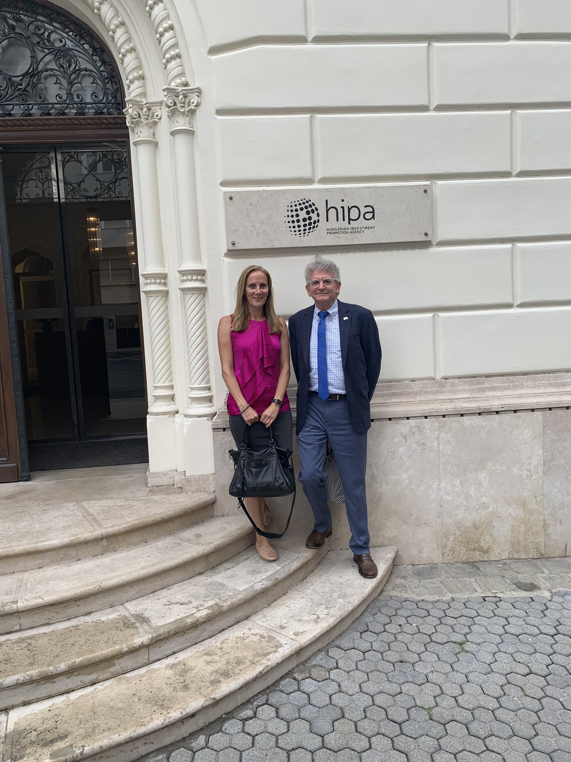
CONTACT
John Parkerson – john.parkerson@outlook.com
Melinda Setenyi – msetenyi@gmail.com www.psinternationalstrategies.com
Social: www.linkedin.com/company/p-s-internationalstrategies

